Slide 1
St. Louis Central Corridor West Building Permits
Monthly Report: December 2020

Slide 2
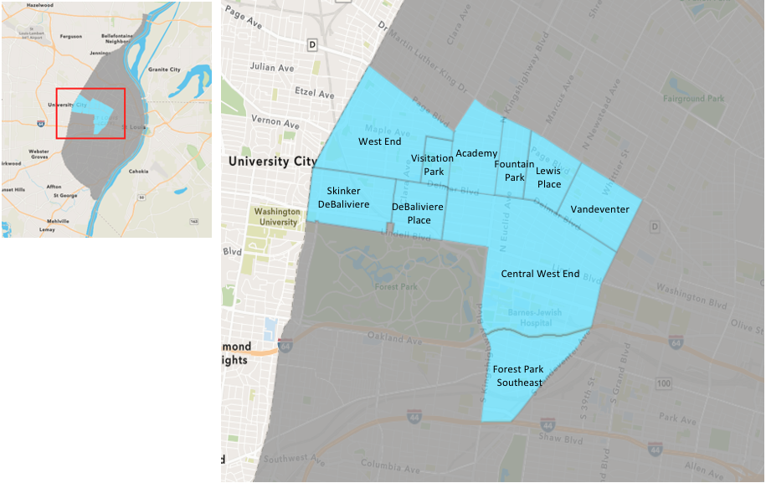
St. Louis Neighborhood Spatial Reference

Slide 3
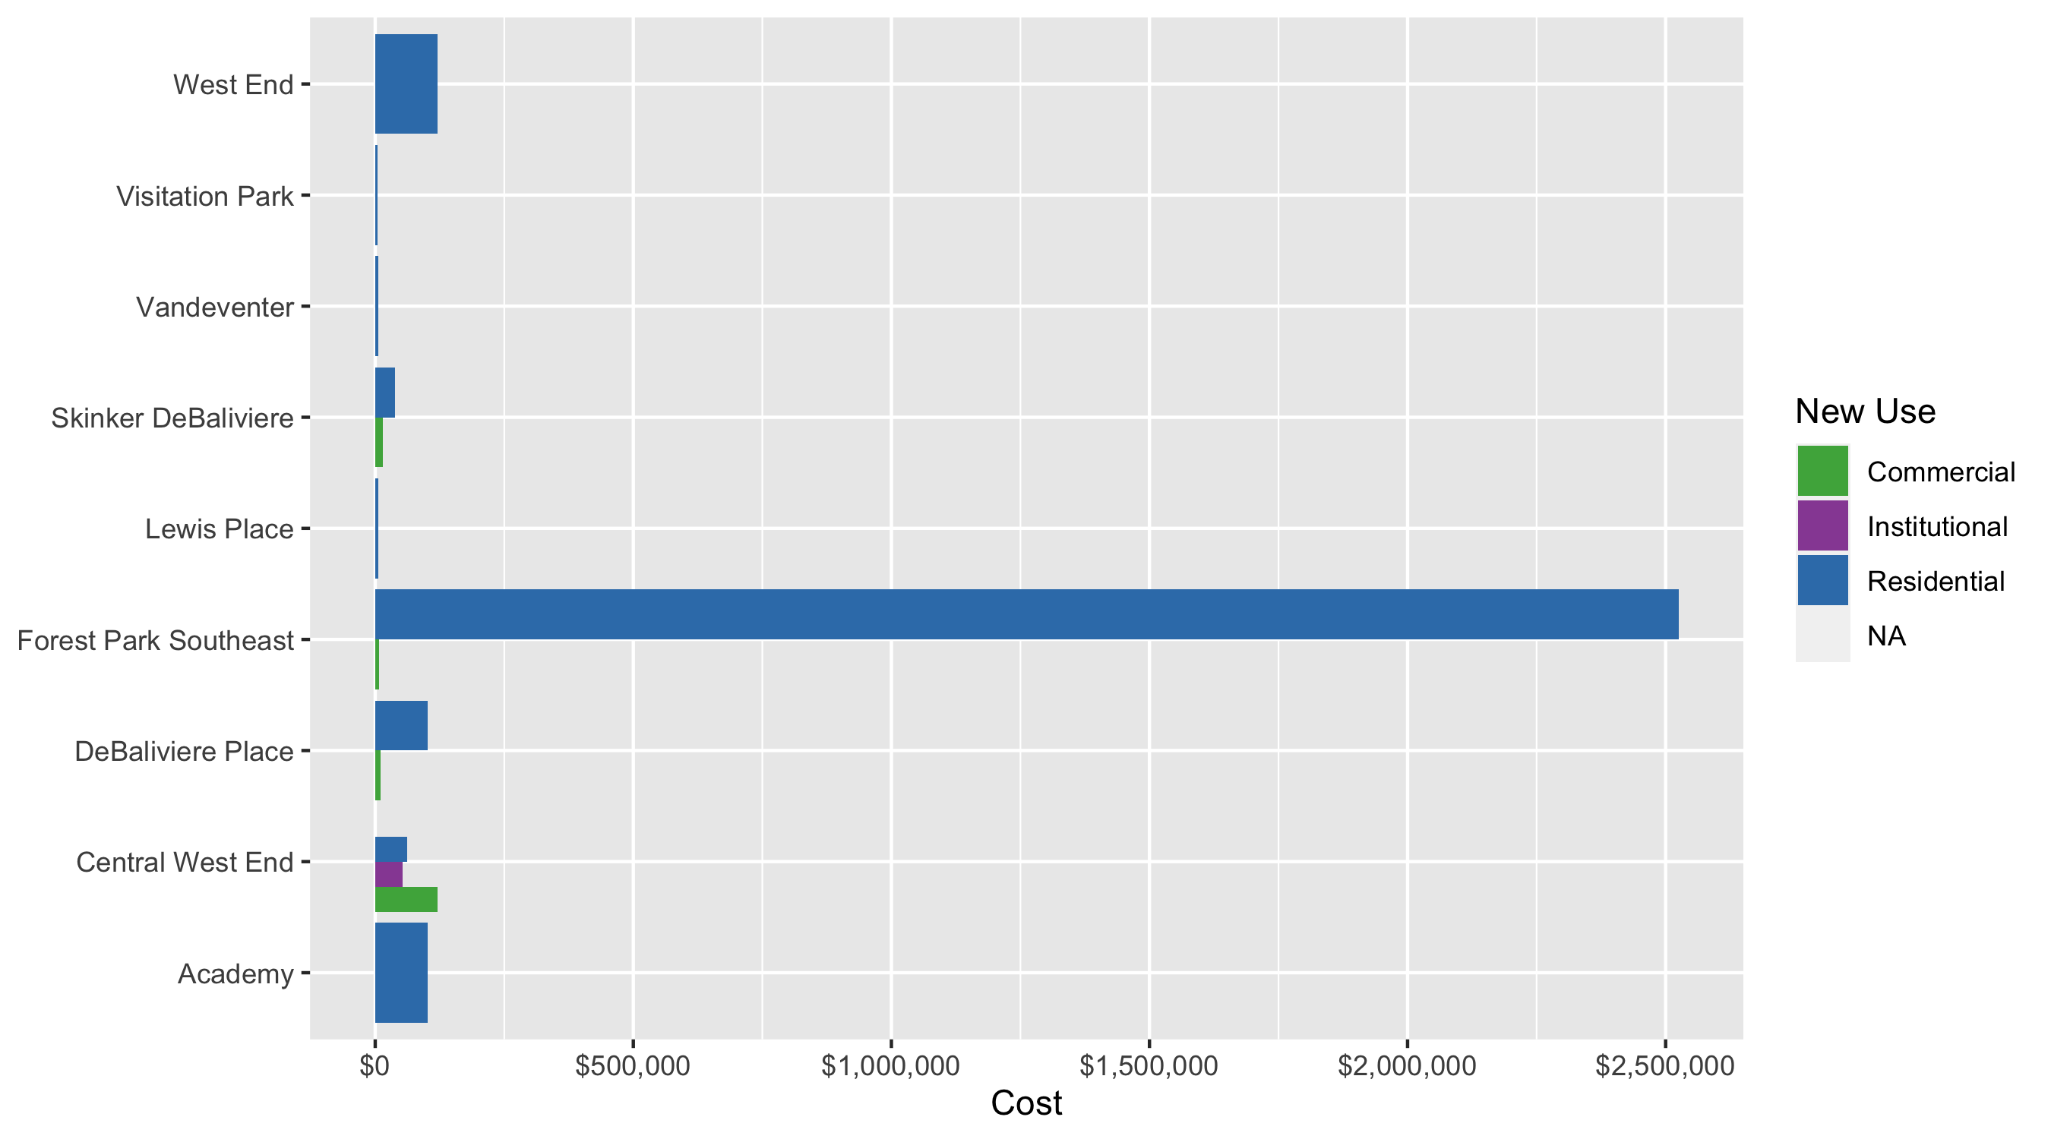
Neighborhood Summary: Average Building Permit Cost

Slide 4
Neighborhood Summary
December 2020 | December 2020 | December 2020 | December 2020
Neighborhood | Average Cost | # of Permits | Total Value of Permits
Academy | $101,000 | 2 | $202,000
Central West End | $69,556 | 47 | $3,269,139
DeBaliviere Place | $88,765 | 7 | $621,357
Forest Park Southeast | $2,021,356 | 10 | $20,213,562
Fountain Park | $0 | 0 | $0
Lewis Place | $5,993 | 5 | $29,963
Skinker DeBaliviere | $33,400 | 10 | $334,000
Vandeventer | $6,000 | 1 | $6,000
Visitation Park | $5,137 | 2 | $10,274
West End | $121,254 | 9 | $1,091,285
Last 6 Months | Last 6 Months | Last 6 Months | Last 6 Months
Neighborhood | Average Cost | # of Permits | Total Value of Permits
Academy | $24,294 | 28 | $680,219
Central West End | $388,213 | 227 | $88,124,422
DeBaliviere Place | $341,088 | 38 | $12,961,343
Forest Park Southeast | $4,506,211 | 73 | $328,953,381
Fountain Park | $102,500 | 2 | $205,000
Lewis Place | $26,648 | 15 | $399,723
Skinker DeBaliviere | $109,975 | 60 | $6,598,521
Vandeventer | $35,219 | 9 | $316,972
Visitation Park | $16,413 | 6 | $98,479
West End | $55,507 | 51 | $2,830,840

Slide 5
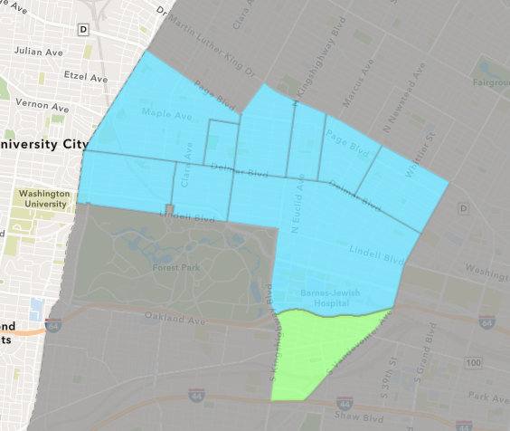
Forest Park Southeast
December 2020 Neighborhood Cost Breakdown
Mean: $2,021,356
Median: $2,530,121
Range: $4,000 - $4,142,141

Slide 6
Forest Park Southeast: Summary Notes
10 building permits in December 2020
25.00% change compared to December 2019 (8 total building permits)
$2,021,356: Average building permit cost in December 2020
166.30% change compared to December 2019 ($759,050)
123 total building permits in 2020
-28.49% change YTD compared to this time in 2019 (172 total building permits)
$2,691,675: YTD average building permit cost in 2020
1132.41% change YTD compared to this time in 2019 ($218,408)

Slide 7
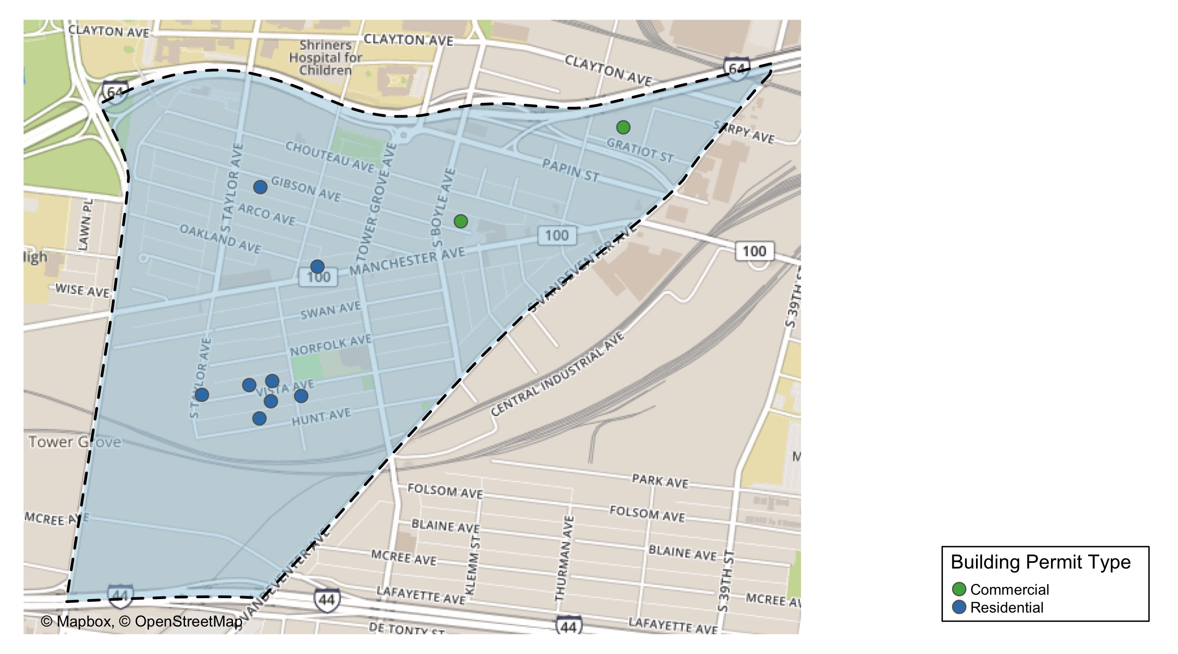
Forest Park Southeast

Slide 8
Neighborhood Summary
December 2020 | December 2020 | December 2020 | December 2020
Permit Use | Average Cost | # of Permits | Total Value of Permits
Commercial | $7,000 | 2 | $14,000
Industrial | $0 | 0 | $0
Institutional | $0 | 0 | $0
Residential | $2,524,945 | 8 | $20,199,562
Last 6 Months | Last 6 Months | Last 6 Months | Last 6 Months
Permit Use | Average Cost | # of Permits | Total Value of Permits
Commercial | $47,191 | 11 | $519,100
Industrial | $267,033 | 3 | $801,100
Institutional | $513,054 | 9 | $4,617,489
Residential | $6,460,314 | 50 | $323,015,692

Slide 9
Forest Park Southeast Individual Permit Breakdown
Owner | New Use | Cost | address
GROVE PLACE 3 LLC | Residential | $150,000 | 4330 ARCO AV
LONI PROPERTIES CO | Commercial | $4,000 | 4121 MANCHESTER AV
GS VISTA LLC | Residential | $3,790,520 | 4447 HUNT AV
GS VISTA LLC | Residential | $2,777,263 | 4453 VISTA AV
GS VISTA LLC | Residential | $2,282,979 | 4420 NORFOLK AV
GS VISTA LLC | Residential | $4,142,141 | 4484 VISTA AV
UNIFY GROVE DEVELOPMENT LLC | Residential | $3,821,501 | 4402 VISTA AV
HOLTZMAN PROPERTIES LLC | Commercial | $10,000 | 4011 PAPIN ST
UNIFY GROVE DEVELOPMENT LLC | Residential | $3,230,158 | 4401 VISTA AV
ERS HOMES LLC | Residential | $5,000 | 4439 OAKLAND AV

Slide 10
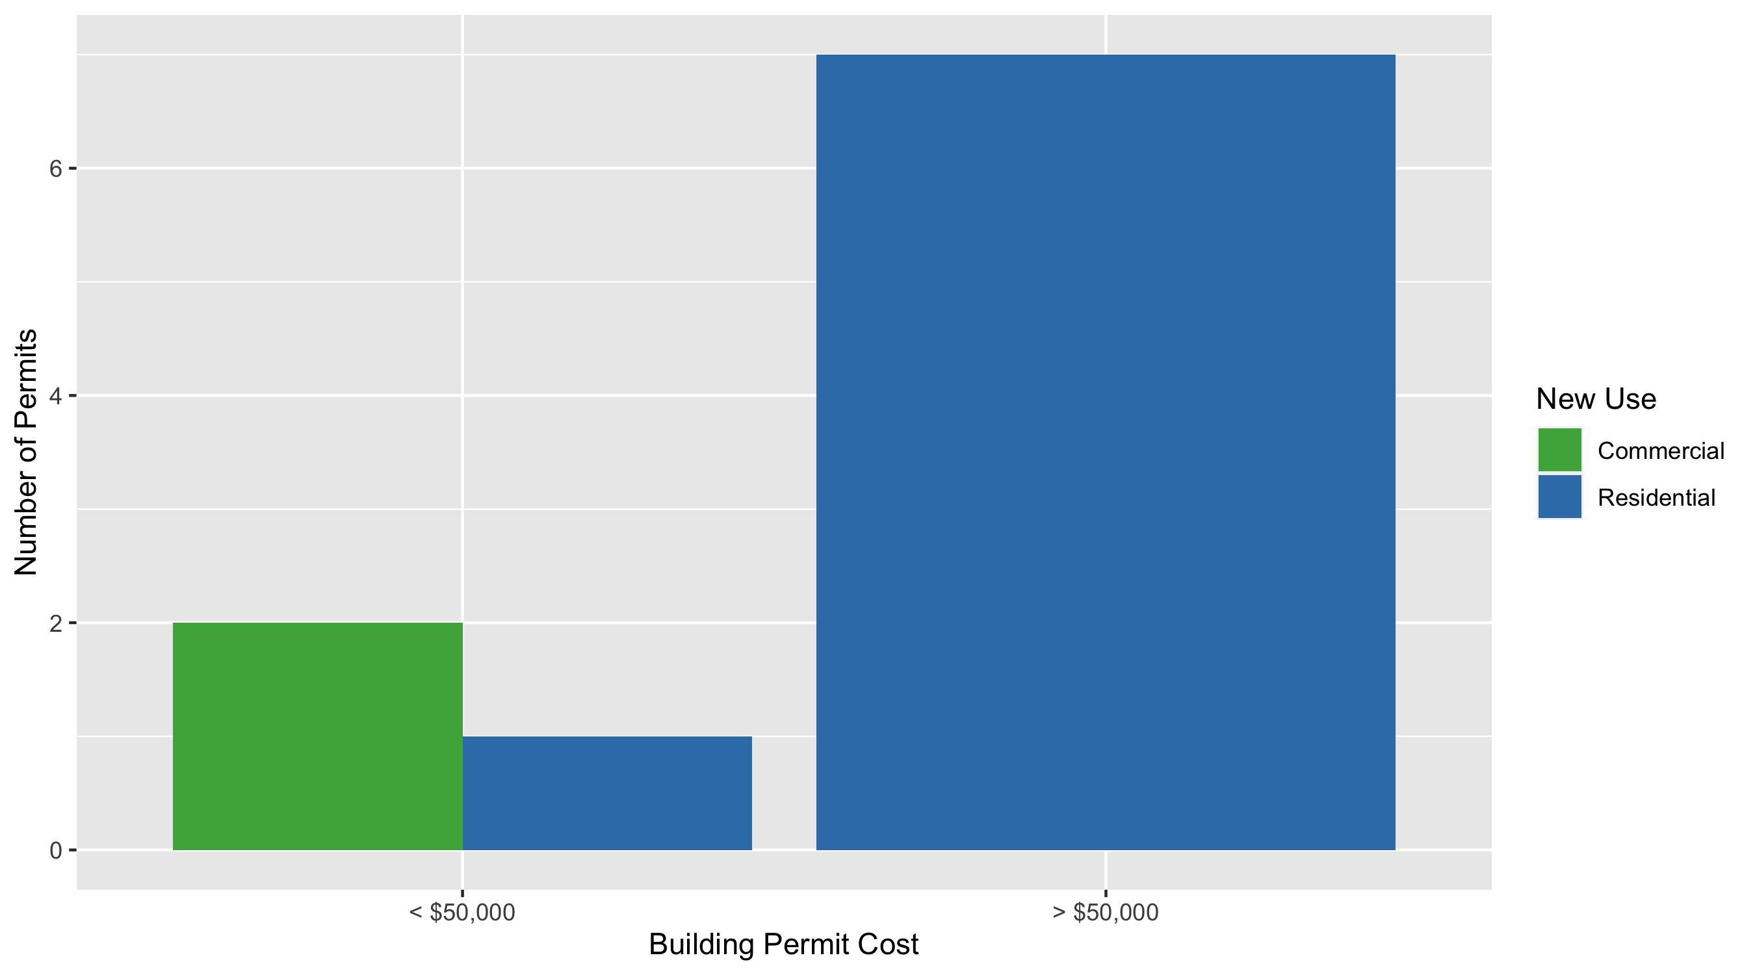
Forest Park Southeast Permit Cost Breakdown

Slide 11
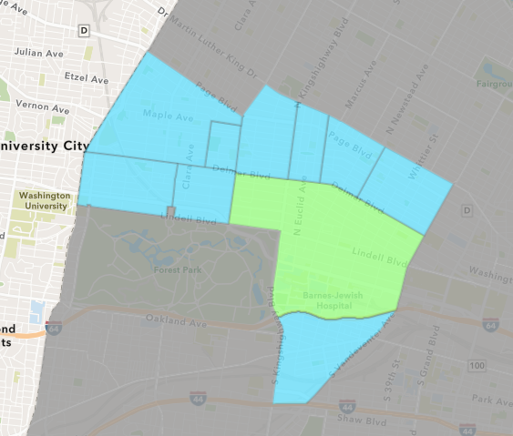
Central West End
December 2020 Neighborhood Cost Breakdown
Mean: $69,556
Median: $19,150
Range: $1,815 - $800,000

Slide 12
Central West End: Summary Notes
47 building permits in December 2020
6.82% change compared to December 2019 (44 total building permits)
$69,556: Average building permit cost in December 2020
-87.56% change compared to December 2019 ($559,063)
431 total building permits in 2020
-12.75% change YTD compared to this time in 2019 (494 total building permits)
$366,177: YTD average building permit cost in 2020
42.11% change YTD compared to this time in 2019 ($257,680)

Slide 13
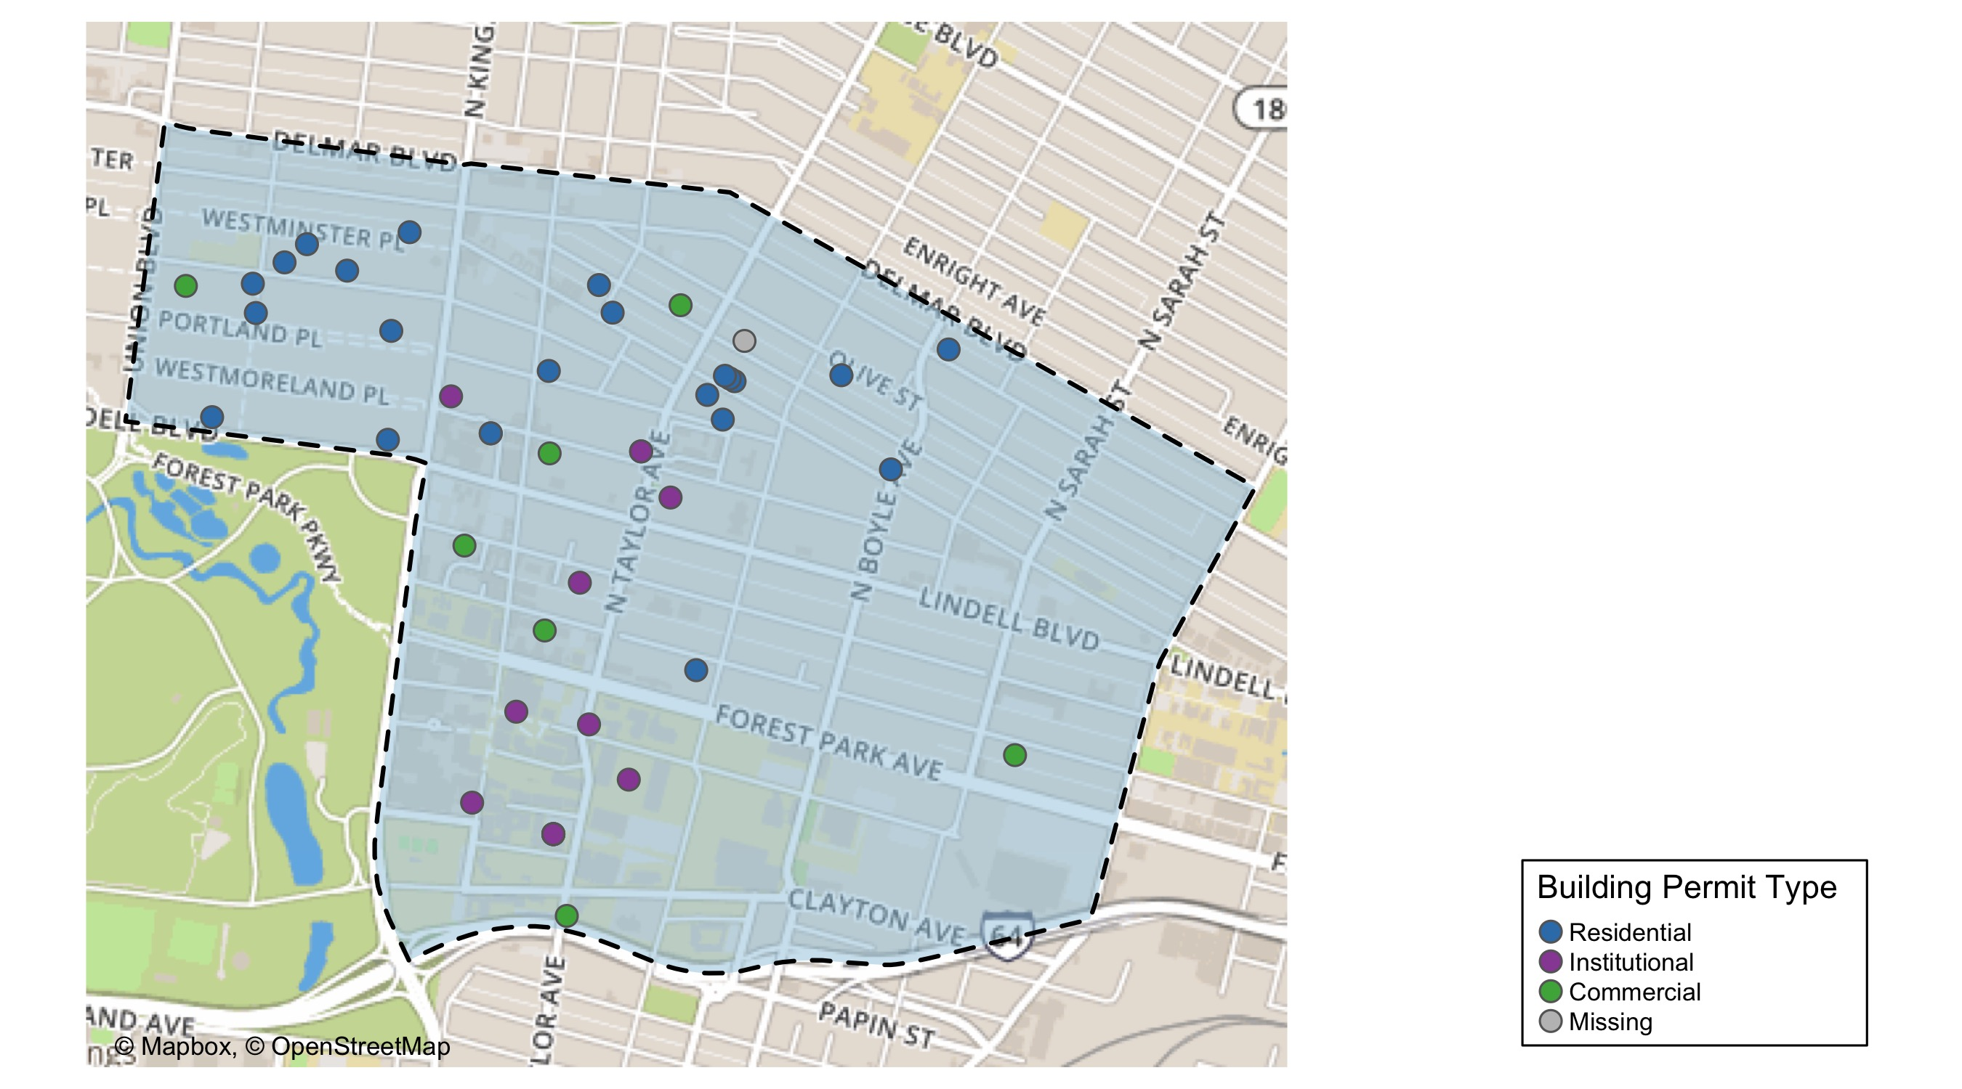
Central West End

Slide 14
Central West End
December 2020 | December 2020 | December 2020 | December 2020
Permit Use | Average Cost | # of Permits | Total Value of Permits
0 | $4,000 | 1 | $4,000
Commercial | $120,601 | 9 | $1,085,405
Industrial | $0 | 0 | $0
Institutional | $53,135 | 13 | $690,758
Residential | $62,041 | 24 | $1,488,976
Last 6 Months | Last 6 Months | Last 6 Months | Last 6 Months
Permit Use | Average Cost | # of Permits | Total Value of Permits
0 | $4,000 | 1 | $4,000
Commercial | $70,530 | 36 | $2,539,071
Industrial | $0 | 0 | $0
Institutional | $600,909 | 73 | $43,866,381
Residential | $356,538 | 117 | $41,714,970

Slide 15
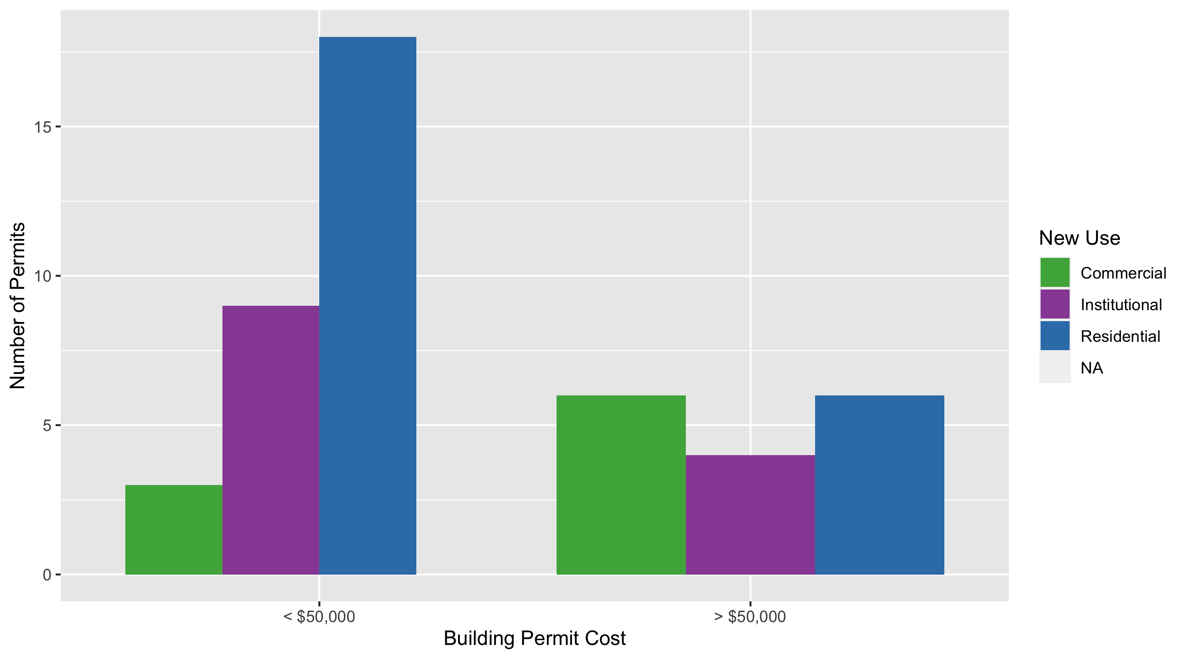
Cental West End Permit Cost Breakdown

Slide 16
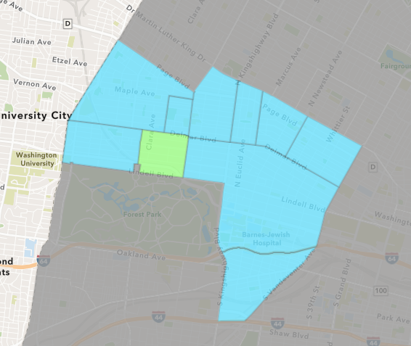
DeBaliviere Place
December 2020 Neighborhood Cost Breakdown
Mean: $88,765
Median: $75,000
Range: $1,200 - $250,000

Slide 17
DeBaliviere Place: Summary Notes
7 building permits in December 2020
133.33% change compared to December 2019 (3 total building permits)
$88,765: Average building permit cost in December 2020
7.93% change compared to December 2019 ($82,247)
60 total building permits in 2020
7.14% change YTD compared to this time in 2019 (56 total building permits)
$576,828: YTD average building permit cost in 2020
1032.15% change YTD compared to this time in 2019 ($50,950)

Slide 18
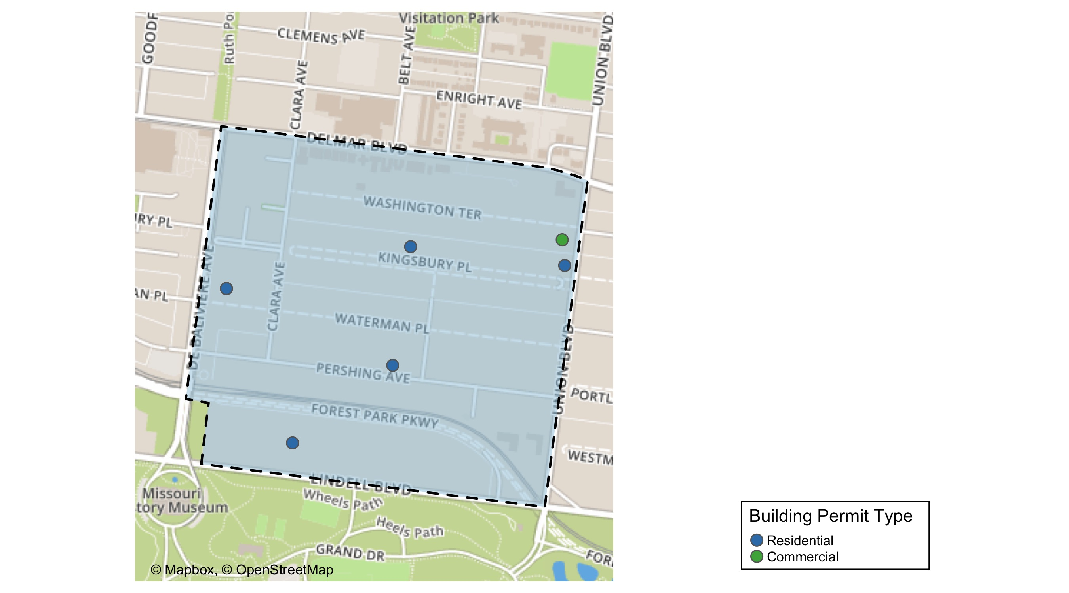
DeBaliviere Place

Slide 19
DeBaliviere Place
December 2020 | December 2020 | December 2020 | December 2020
Permit Use | Average Cost | # of Permits | Total Value of Permits
Commercial | $10,000 | 1 | $10,000
Industrial | $0 | 0 | $0
Institutional | $0 | 0 | $0
Residential | $101,893 | 6 | $611,357
Last 6 Months | Last 6 Months | Last 6 Months | Last 6 Months
Permit Use | Average Cost | # of Permits | Total Value of Permits
Commercial | $7,195 | 4 | $28,780
Industrial | $0 | 0 | $0
Institutional | $400 | 1 | $400
Residential | $391,884 | 33 | $12,932,163

Slide 20
DeBaliviere Place Individual Permit Breakdown
Owner | New Use | Cost | Address
WATERMAN-KINGSBURY CONDOMINIUM | Residential | $75,000 | 5696 KINGSBURY AV
REID, JENNY L & KEVIN M | Residential | $128,957 | 48 WASHINGTON TER
SHAUGHNESSY, JAMES A & KAREN L TRS | Residential | $150,000 | 5533 LINDELL BLVD
MINHAAT BOTNIM LLC | Residential | $1,200 | 311 BELT AV
DEL-CLARA APARTMENTS LLC | Commercial | $10,000 | 5600-5610 DELMAR BLVD
CHIANG, LESTER | Residential | $6,200 | 5696 KINGSBURY AV
DEL MONTE APARTMENTS LLC | Residential | $250,000 | 5622 DELMAR BLVD

Slide 21
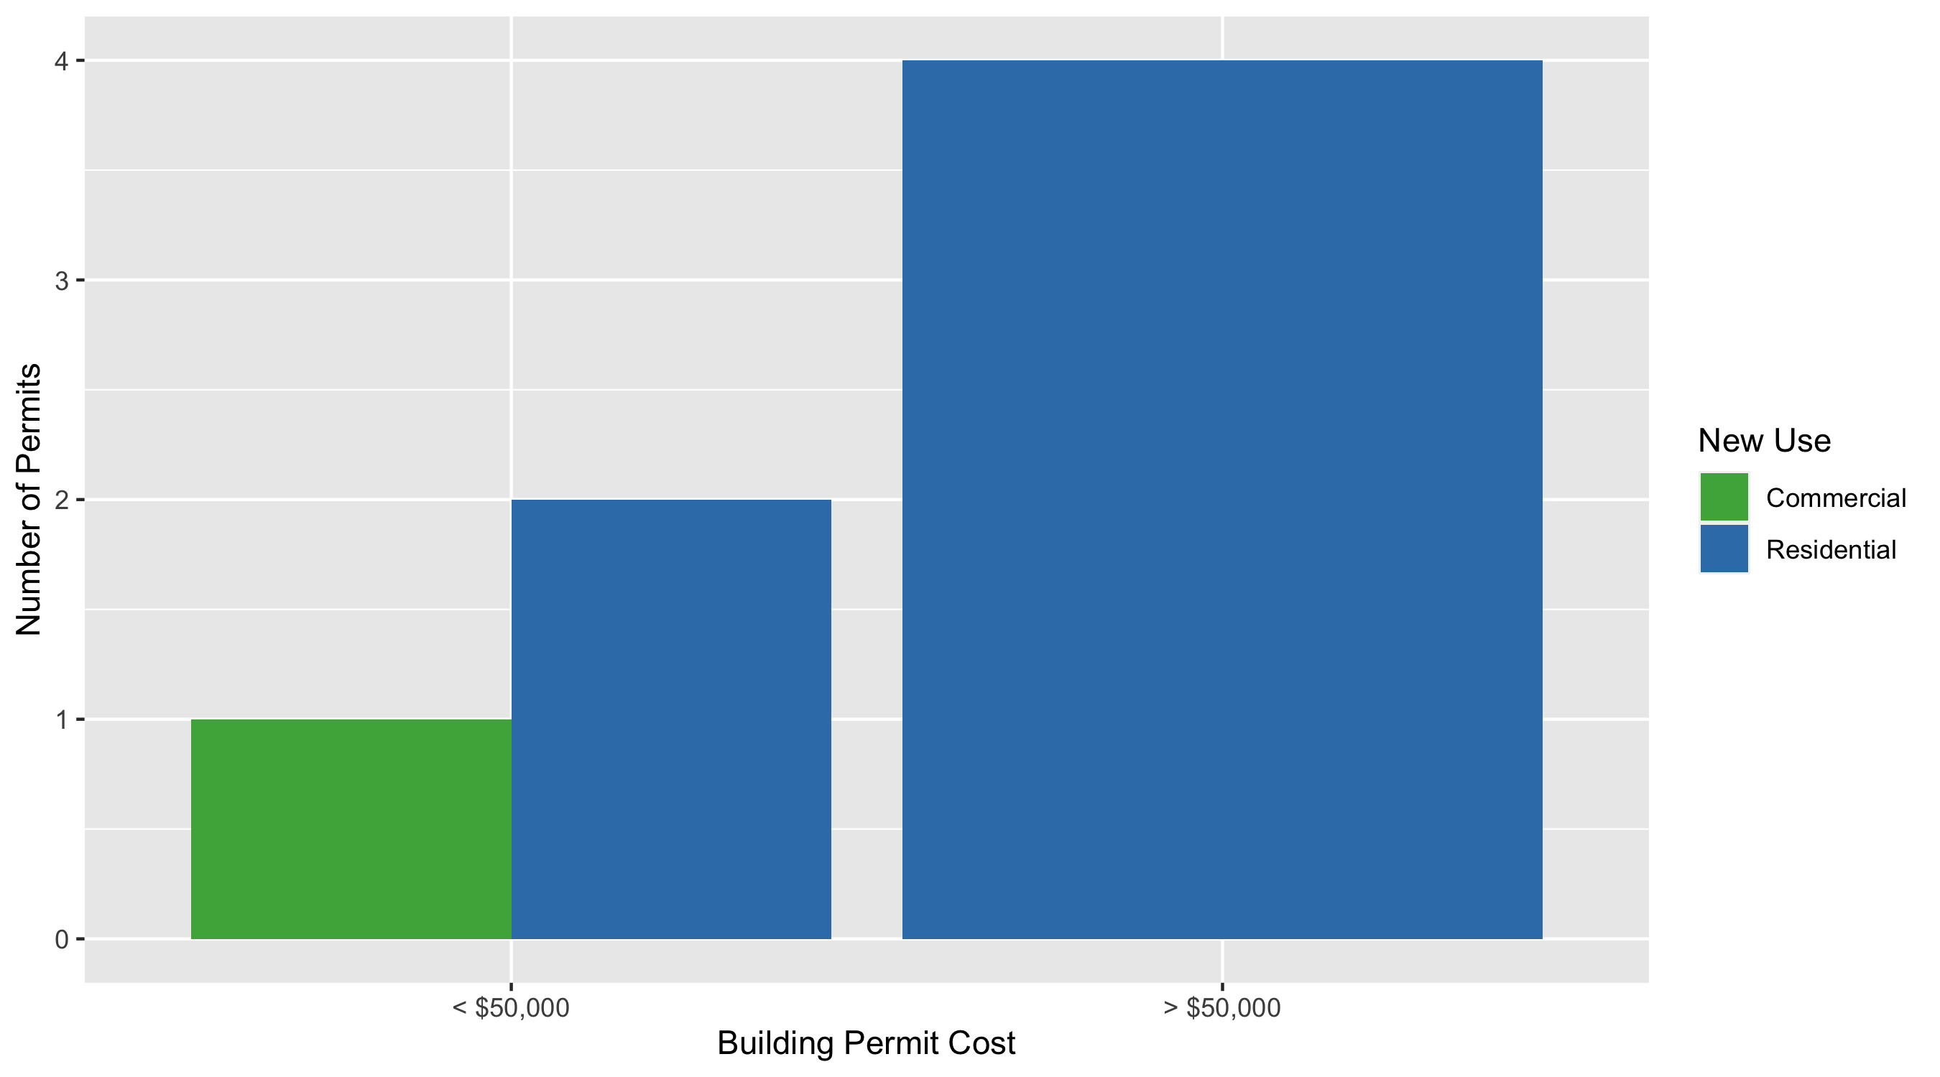
DeBaliviere Place Permit Cost Breakdown

Slide 22
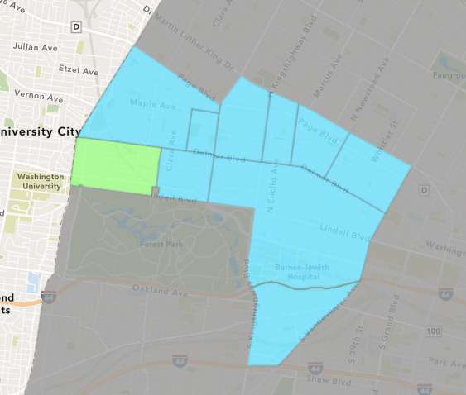
Skinker DeBaliviere
December 2020 Neighborhood Cost Breakdown
Mean: $33,400
Median: $21,000
Range: $1,000 - $72,000

Slide 23
Skinker DeBaliviere: Summary Notes
10 building permits in December 2020
42.86% change compared to December 2019 (7 total building permits)
$33,400: Average building permit cost in December 2020
10.81% change compared to December 2019 ($30,143)
124 total building permits in 2020
65.33% change YTD compared to this time in 2019 (75 total building permits)
$544,001: YTD average building permit cost in 2020
2480.89% change YTD compared to this time in 2019 ($21,078)

Slide 24
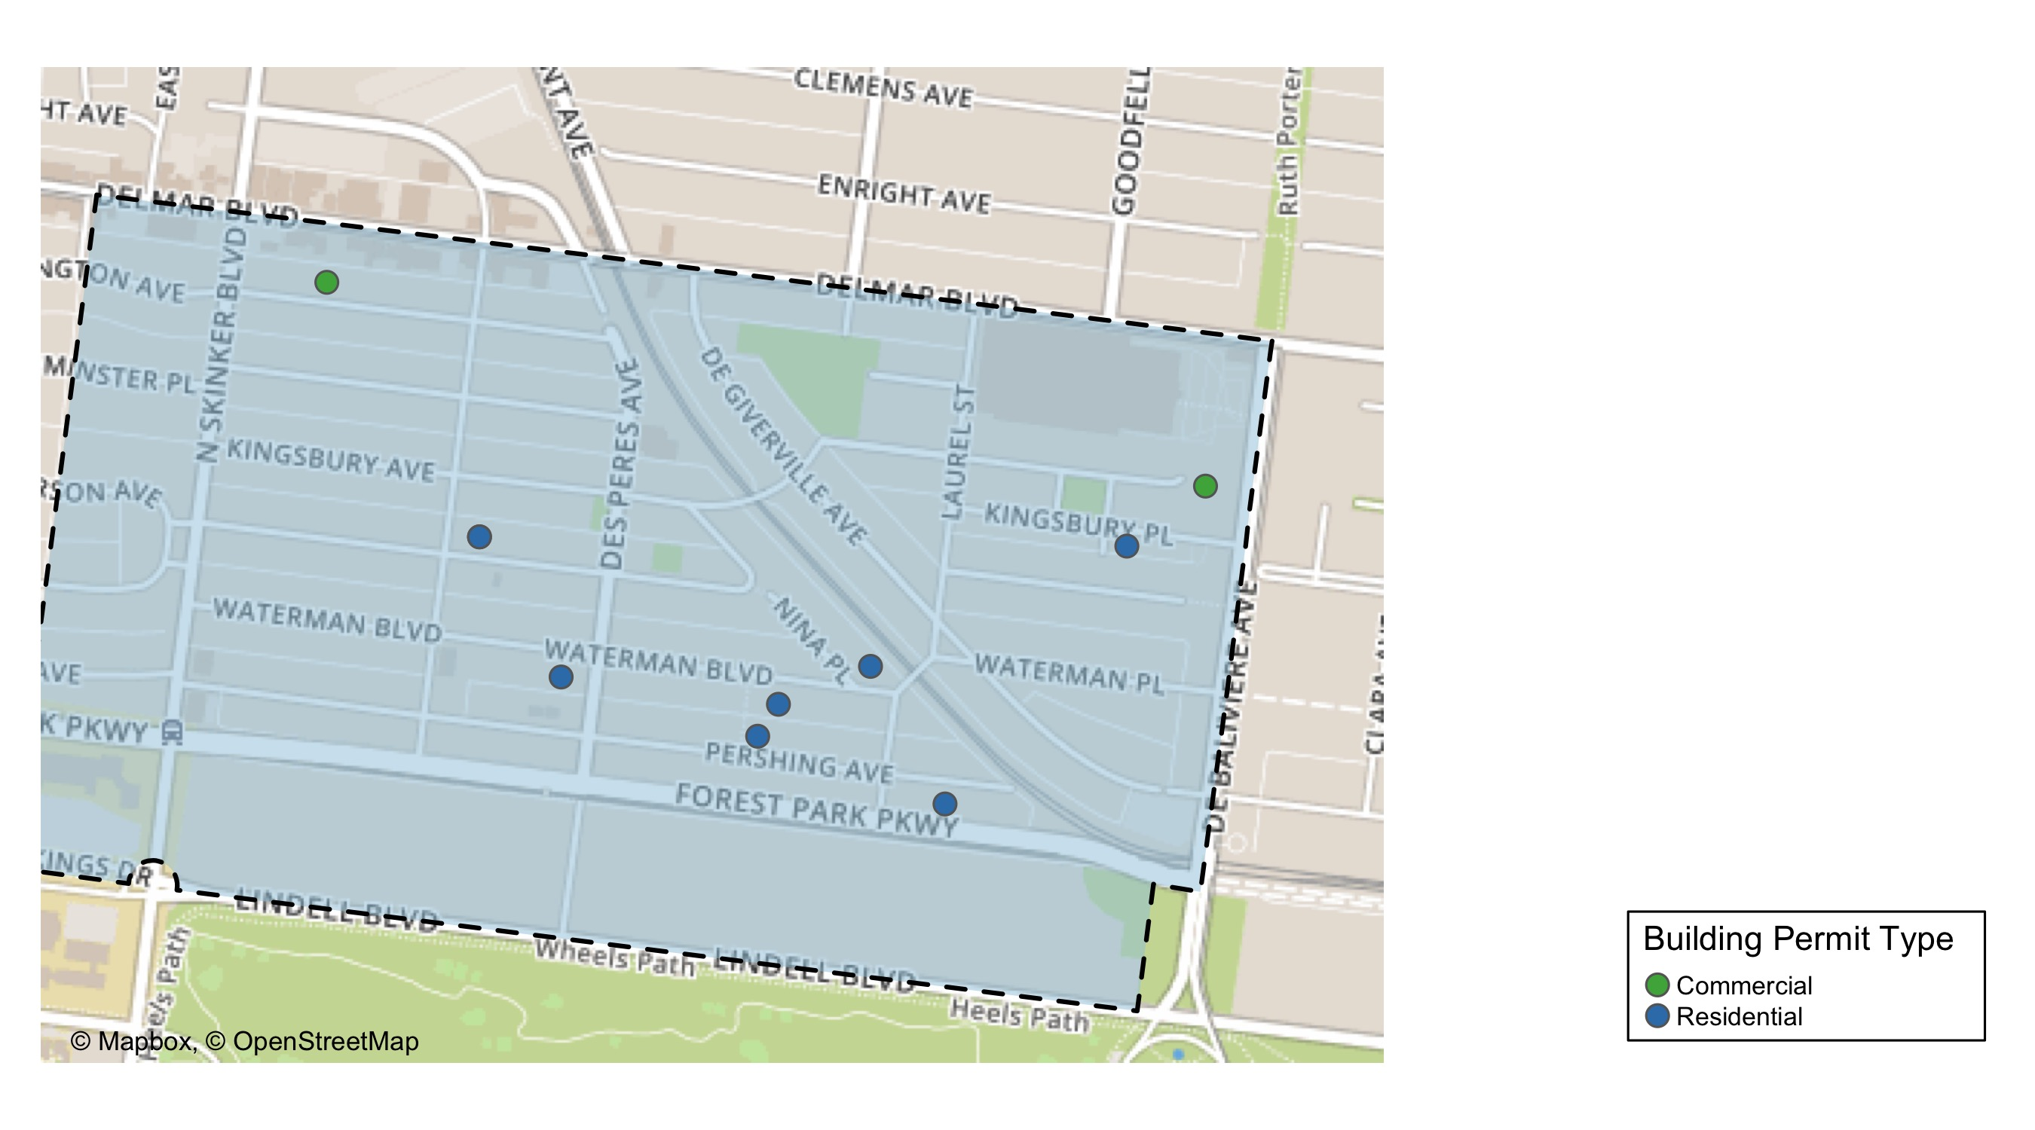
Skinker DeBaliviere

Slide 25
Skinker DeBaliviere
December 2020 | December 2020 | December 2020 | December 2020
Permit Use | Average Cost | # of Permits | Total Value of Permits
Commercial | $15,500 | 2 | $31,000
Industrial | $0 | 0 | $0
Institutional | $0 | 0 | $0
Residential | $37,875 | 8 | $303,000
Last 6 Months | Last 6 Months | Last 6 Months | Last 6 Months
Permit Use | Average Cost | # of Permits | Total Value of Permits
Commercial | $77,488 | 9 | $697,390
Industrial | $0 | 0 | $0
Institutional | $622,267 | 6 | $3,733,601
Residential | $48,167 | 45 | $2,167,530

Slide 26
Skinker DeBaliviere Individual Permit Breakdown
Owner | New Use | Cost | Address
THE WASHINGTON UNIVERSITY | Residential | $72,000 | 6001-05 MCPHERSON AV
WASHINGTON UNIVERSITY | Residential | $72,000 | 353 DES PERES AV
THE WASHINGTON UNIVERSITY | Residential | $72,000 | 6001 MCPHERSON AV
CLARKE, MARY THERESE TRS | Residential | $22,000 | 5897 NINA PL
LIFE INTERESTS LLC | Residential | $20,000 | 5809 PERSHING AV
LIFE INTERESTS LLC | Residential | $20,000 | 5946 WATERMAN BLVD
ELOSIEBO, MECHELLE & | Residential | $10,000 | 5806 DEGIVERVILLE AV
LOOP CENTER SOUTH LLC | Commercial | $1,000 | 6120 DELMAR BLVD
BI-STATE DEVELOPMENT AGENCY | Commercial | $30,000 | 567 DEBALIVIERE AV
NICHOLS, GENEVIEVE | Residential | $15,000 | 5738 DEGIVERVILLE AV

Slide 27
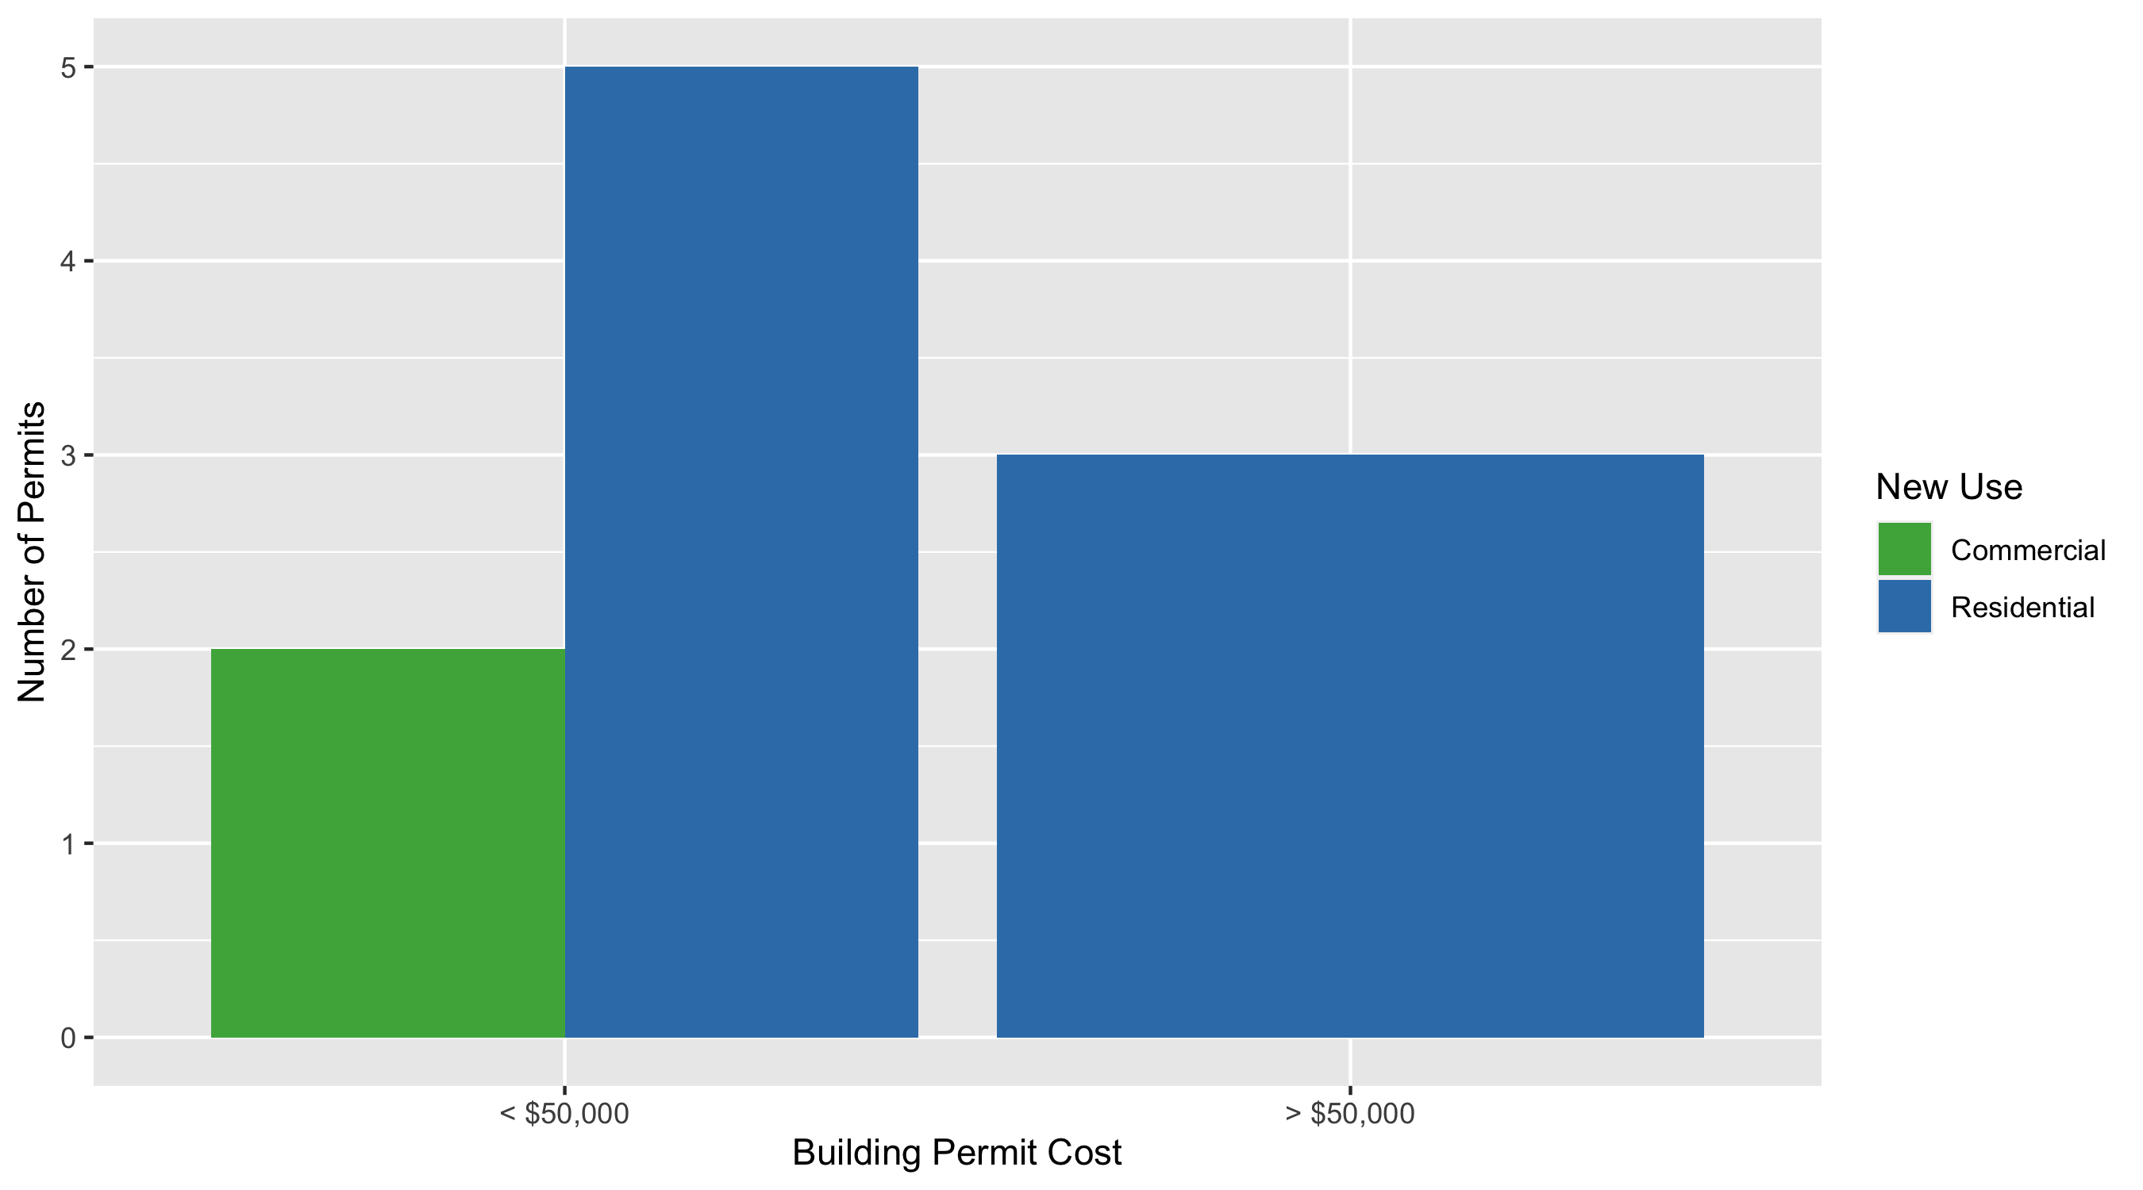
Skinker DeBaliviere Permit Cost Breakdown

Slide 28
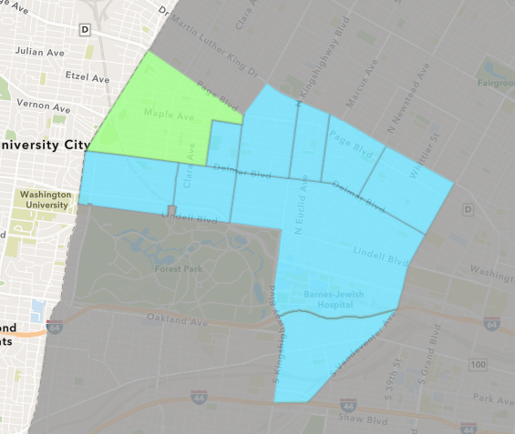
West End
December 2020 Neighborhood Cost Breakdown
Mean: $121,254
Median: $5,735
Range: $2,000 - $800,000

Slide 29
West End: Summary Notes
9 building permits in December 2020
-10.00% change compared to December 2019 (10 total building permits)
$121,254: Average building permit cost in December 2020
-17.92% change compared to December 2019 ($147,719)
84 total building permits in 2020
47.37% change YTD compared to this time in 2019 (57 total building permits)
$291,000: YTD average building permit cost in 2020
133.74% change YTD compared to this time in 2019 ($124,498)

Slide 30
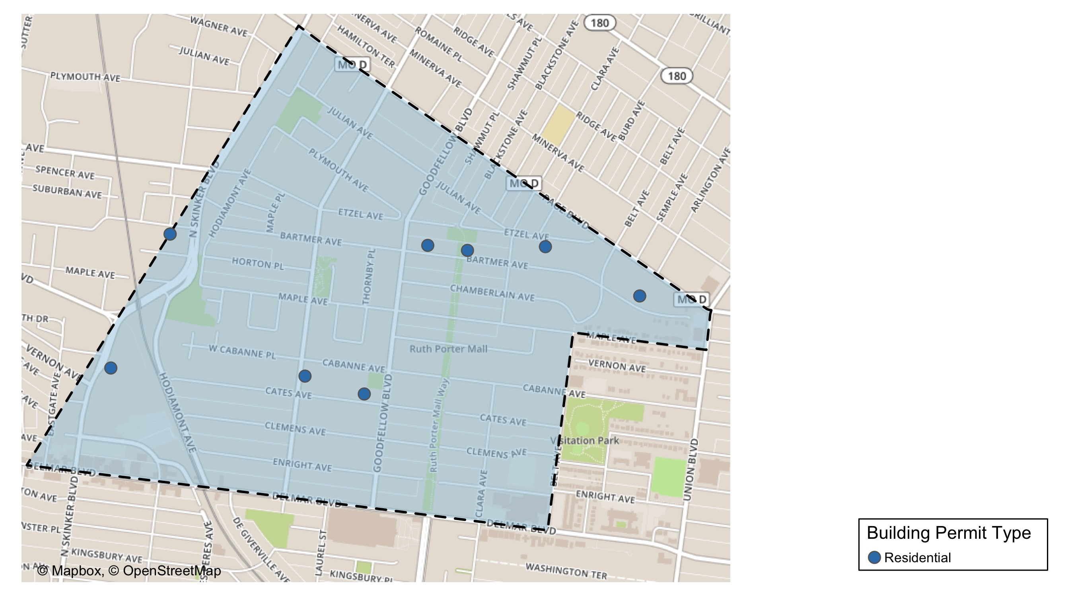
West End

Slide 31
West End
December 2020 | December 2020 | December 2020 | December 2020
Permit Use | Average Cost | # of Permits | Total Value of Permits
Commercial | $0 | 0 | $0
Industrial | $0 | 0 | $0
Institutional | $0 | 0 | $0
Residential | $121,254 | 9 | $1,091,285
Last 6 Months | Last 6 Months | Last 6 Months | Last 6 Months
Permit Use | Average Cost | # of Permits | Total Value of Permits
Commercial | $29,366 | 8 | $234,930
Industrial | $0 | 0 | $0
Institutional | $42,035 | 1 | $42,035
Residential | $60,807 | 42 | $2,553,875

Slide 32
West End Individual Permit Breakdown
Owner | New Use | Cost | Address
RICHARDSON, BONITA B | Residential | $5,735 | 5338 PAGE BLVD
STL ONE LLC | Residential | $36,000 | 1131-35 HODIAMONT AV
STL ONE LLC | Residential | $5,000 | 1141 HODIAMONT AV
NEIGHBORHOOD PROPERTIES LLC | Residential | $800,000 | 5815 CATES AV
ALIAKBARI, DARYOUSH | Residential | $35,000 | 730 EASTGATE AV
DAVIS, LAWANDA S | Residential | $2,000 | 5643-47 BARTMER AV
SGR INVESTMENTS LLC | Residential | $200,000 | 858 HAMILTON AV
KINCADE, MATHEW & ARSENIA J | Residential | $2,850 | 5582 ETZEL AV
CARADINE, LAVELL | Residential | $4,700 | 5727 BARTMER AV

Slide 33
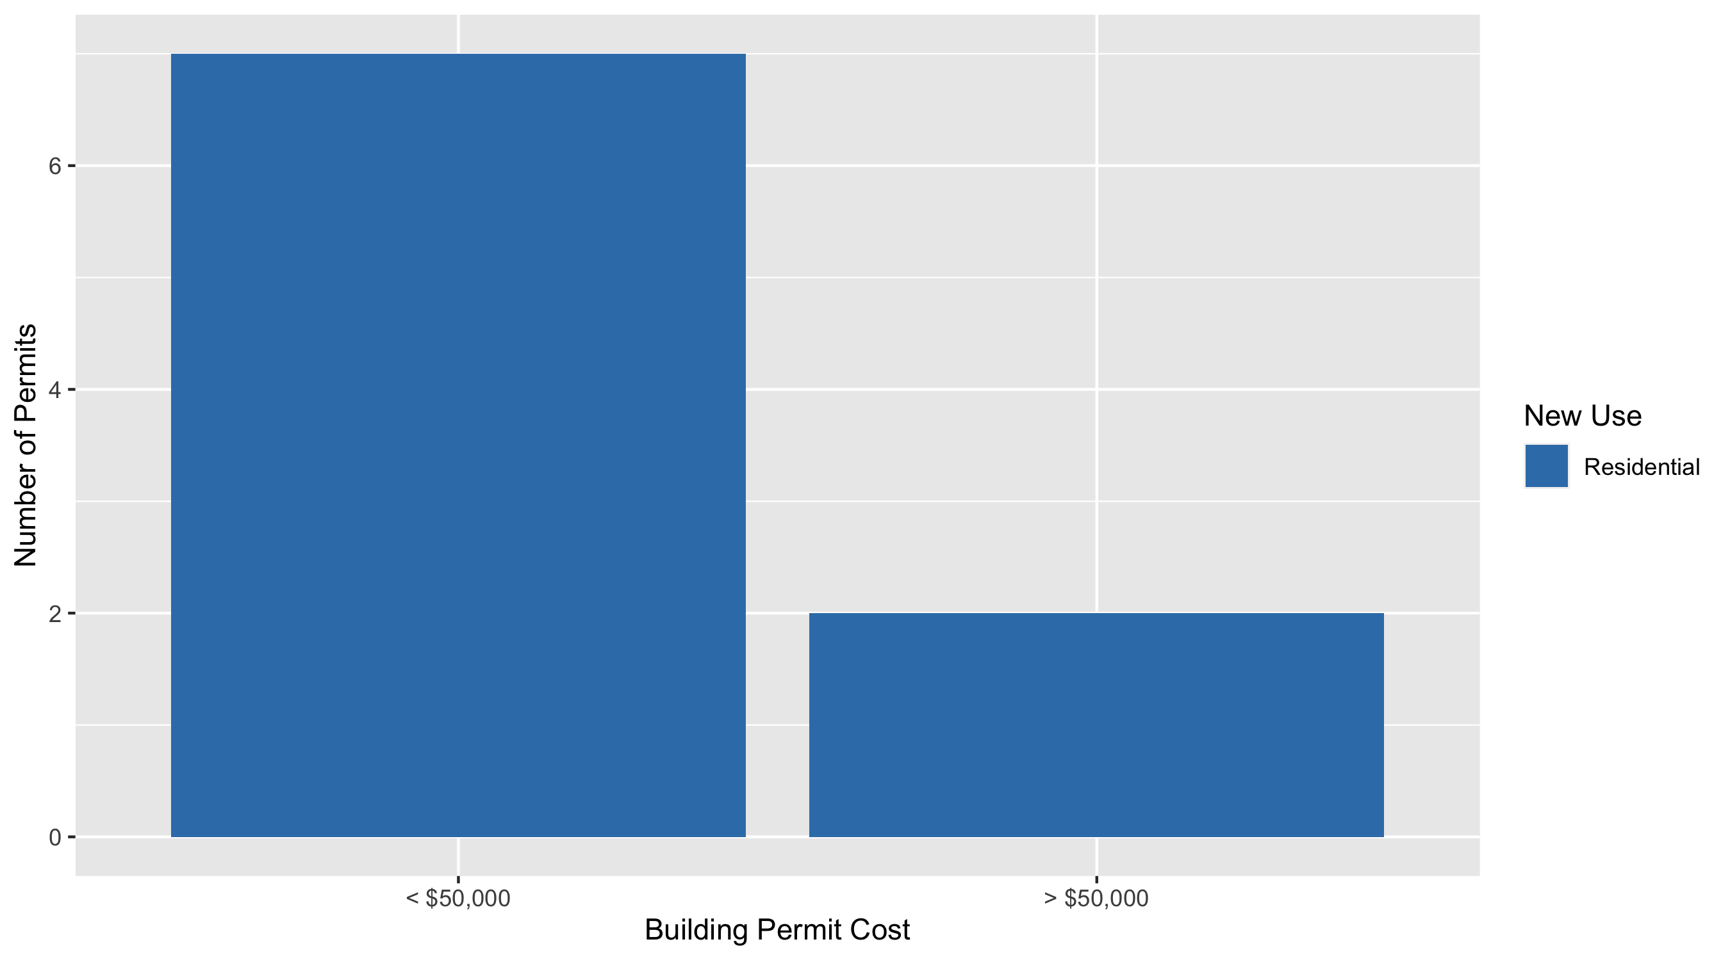
West End Permit Cost Breakdown

Slide 34
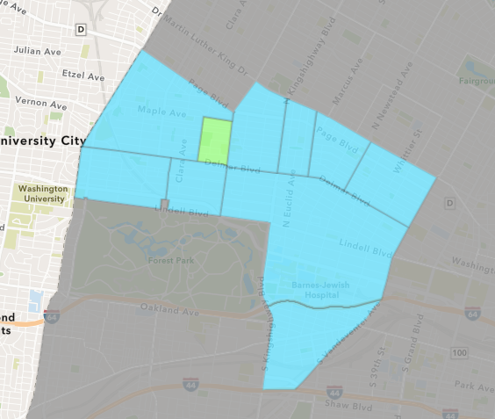
Visitation Park
December 2020 Neighborhood Cost Breakdown
Mean: $5,137
Median: $5,137
Range: $2,500 - $7,774

Slide 35
Visitation Park: Summary Notes
2 building permits in December 2020
Infinite change compared to December 2019 (0 total building permits)
$5,137: Average building permit cost in December 2020
Infinite change compared to December 2019 ($0)
8 total building permits in 2020
700.00% change YTD compared to this time in 2019 (1 total building permits)
$14,966: YTD average building permit cost in 2020
87.08% change YTD compared to this time in 2019 ($8,000)

Slide 36
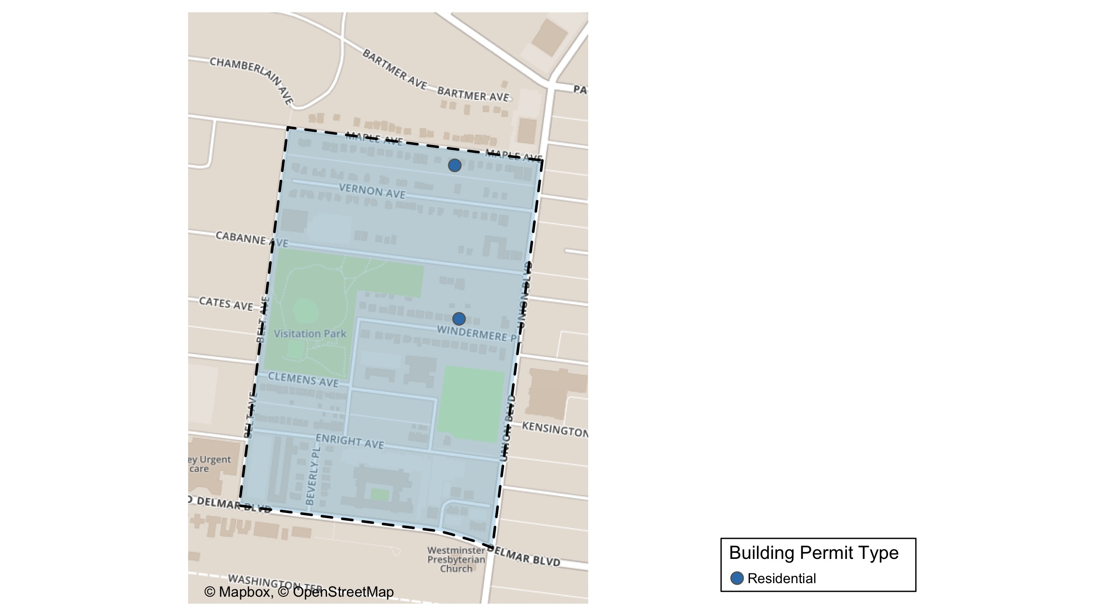
Visitation Park

Slide 37
Visitation Park
December 2020 | December 2020 | December 2020 | December 2020
Permit Use | Average Cost | # of Permits | Total Value of Permits
Commercial | $0 | 0 | $0
Industrial | $0 | 0 | $0
Institutional | $0 | 0 | $0
Residential | $5,137 | 2 | $10,274
Last 6 Months | Last 6 Months | Last 6 Months | Last 6 Months
Permit Use | Average Cost | # of Permits | Total Value of Permits
Commercial | $0 | 0 | $0
Industrial | $0 | 0 | $0
Institutional | $0 | 0 | $0
Residential | $16,413 | 6 | $98,479

Slide 38
Visitation Park Individual Permit Breakdown
Owner | New Use | Cost | Address
BUTLER, BREONA | Residential | $7,774 | 5364 MAPLE AV
EVERETT, EDGAR III & | Residential | $2,500 | 1 WINDERMERE PL

Slide 39
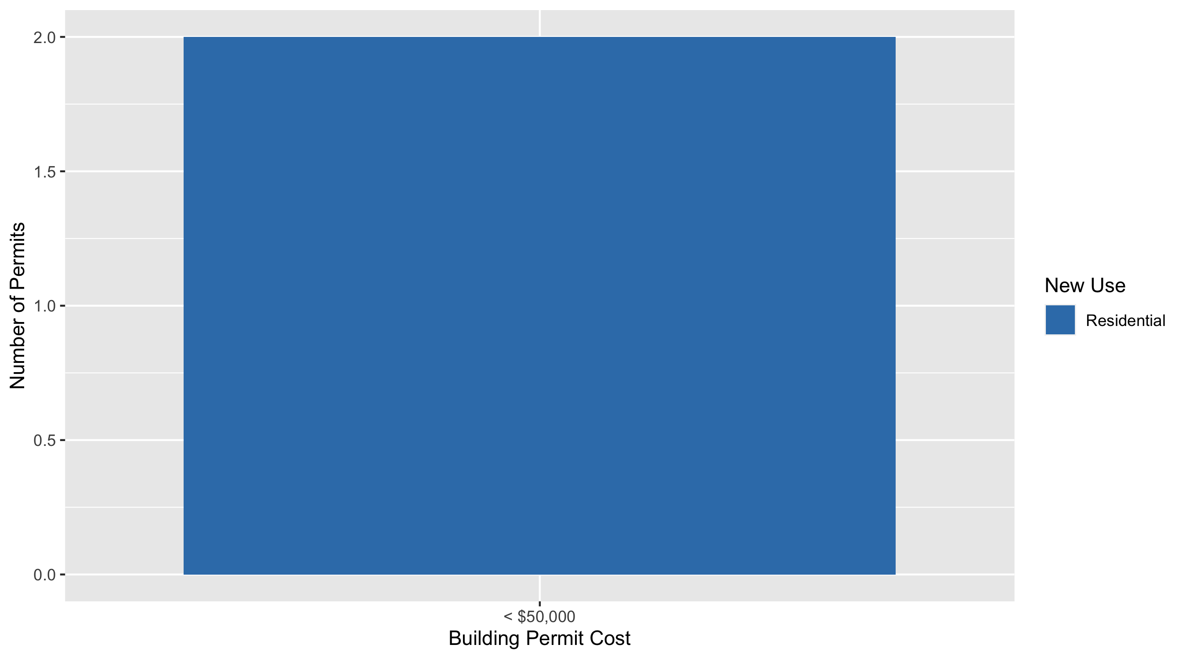
Visitation Park Permit Cost Breakdown

Slide 40
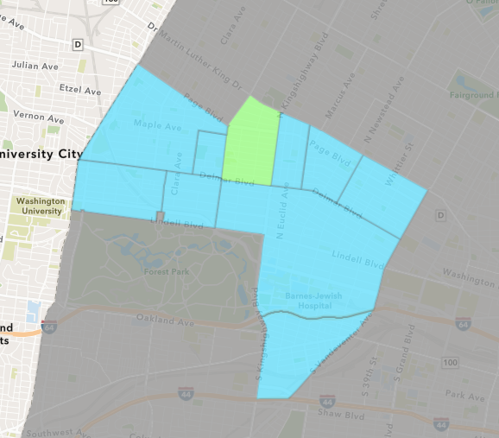
Academy
December 2020 Neighborhood Cost Breakdown
Mean: $101,000
Median: $101,000
Range: $2,000 - $200,000

Slide 41
Academy: Summary Notes
2 building permits in December 2020
-33.33% change compared to December 2019 (3 total building permits)
$101,000: Average building permit cost in December 2020
27.04% change compared to December 2019 ($79,500)
47 total building permits in 2020
30.56% change YTD compared to this time in 2019 (36 total building permits)
$38,837: YTD average building permit cost in 2020
-28.76% change YTD compared to this time in 2019 ($54,518)

Slide 42
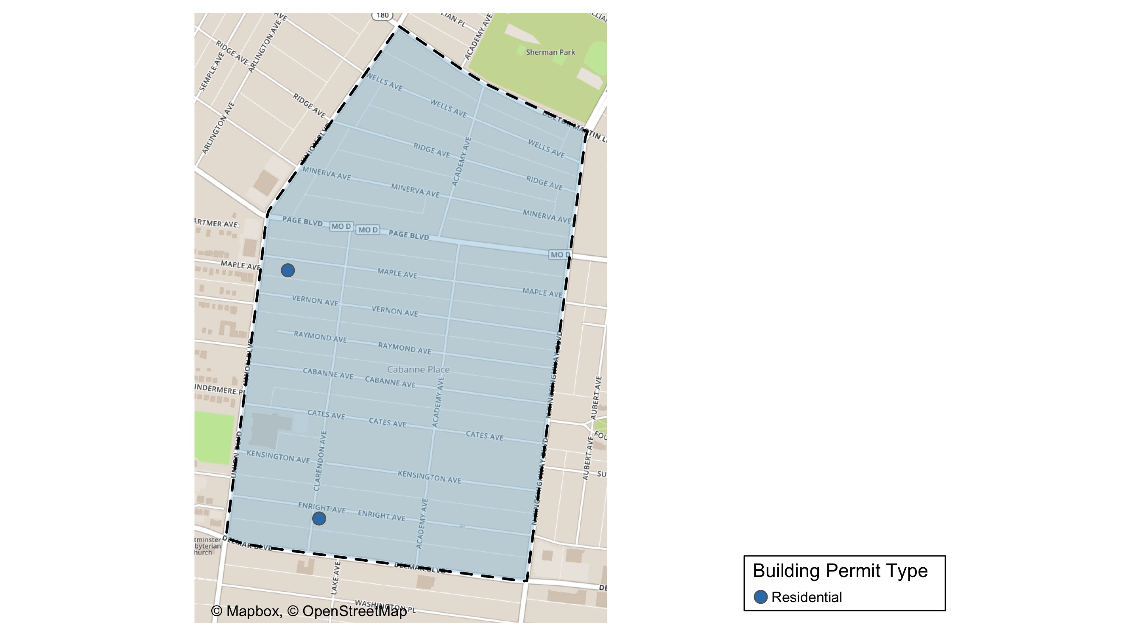
Academy

Slide 43
Academy
December 2020 | December 2020 | December 2020 | December 2020
Permit Use | Average Cost | # of Permits | Total Value of Permits
Commercial | $0 | 0 | $0
Industrial | $0 | 0 | $0
Institutional | $0 | 0 | $0
Residential | $101,000 | 2 | $202,000
Last 6 Months | Last 6 Months | Last 6 Months | Last 6 Months
Permit Use | Average Cost | # of Permits | Total Value of Permits
Commercial | $12,500 | 2 | $25,000
Industrial | $0 | 0 | $0
Institutional | $5,250 | 2 | $10,500
Residential | $26,863 | 24 | $644,719

Slide 44
Academy Individual Permit Breakdown
Owner | New Use | Cost | Address
5258 MAPLE LLC | Residential | $2,000 | 5258 MAPLE AV
GREEN LINE LLC | Residential | $200,000 | 5163 ENRIGHT AV

Slide 45
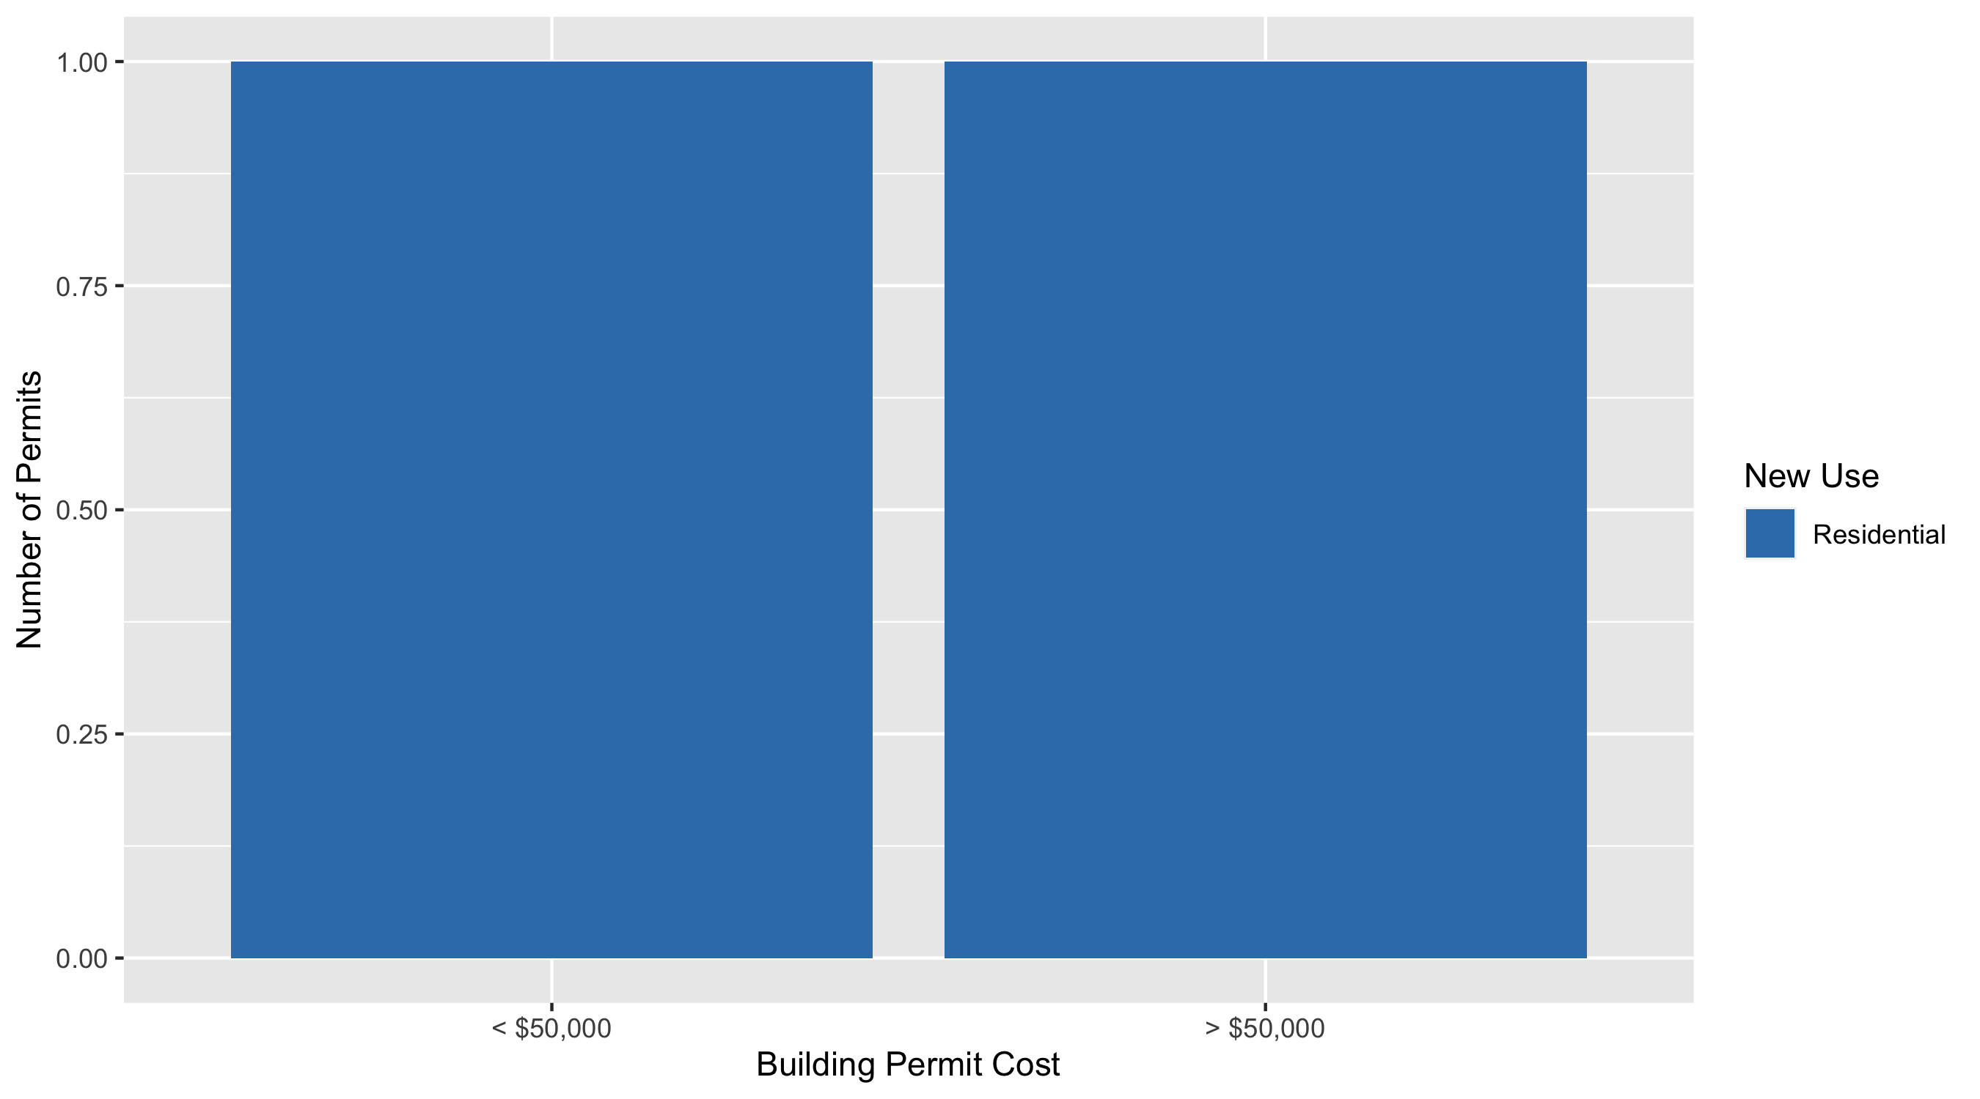
Academy Permit Cost Breakdown

Slide 46
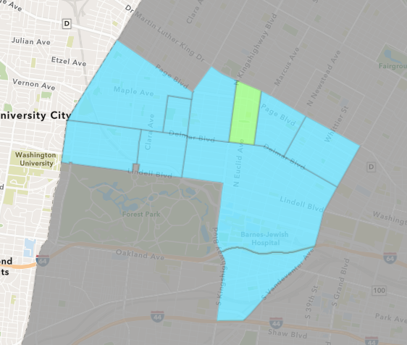
Fountain Park
December 2020 Neighborhood Cost Breakdown
Mean: $0
Median: NA
Range: $0 - $0

Slide 47
Fountain Park: Summary Notes
0 building permits in December 2020
0.00% change compared to December 2019 (0 total building permits)
$0: Average building permit cost in December 2020
0.00% change compared to December 2019 ($0)
6 total building permits in 2020
-45.45% change YTD compared to this time in 2019 (11 total building permits)
$38,083: YTD average building permit cost in 2020
6.82% change YTD compared to this time in 2019 ($35,651)

Slide 48
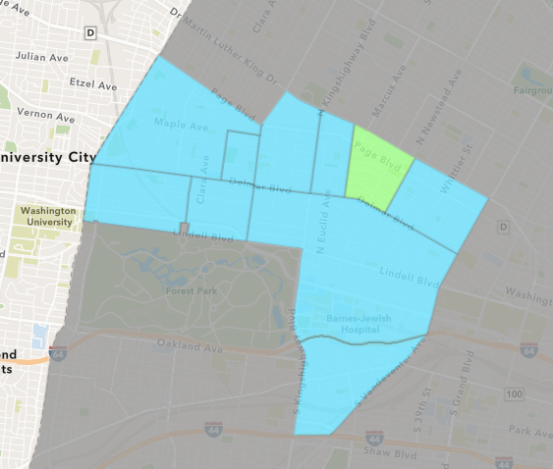
Lewis Place
December 2020 Neighborhood Cost Breakdown
Mean: $5,993
Median: $3,000
Range: $1,000 - $17,640

Slide 49
Lewis Place: Summary Notes
5 building permits in December 2020
Infinite change compared to December 2019 (0 total building permits)
$5,993: Average building permit cost in December 2020
Infinite change compared to December 2019 ($0)
19 total building permits in 2020
111.11% change YTD compared to this time in 2019 (9 total building permits)
$21,206: YTD average building permit cost in 2020
69.50% change YTD compared to this time in 2019 ($12,511)

Slide 50
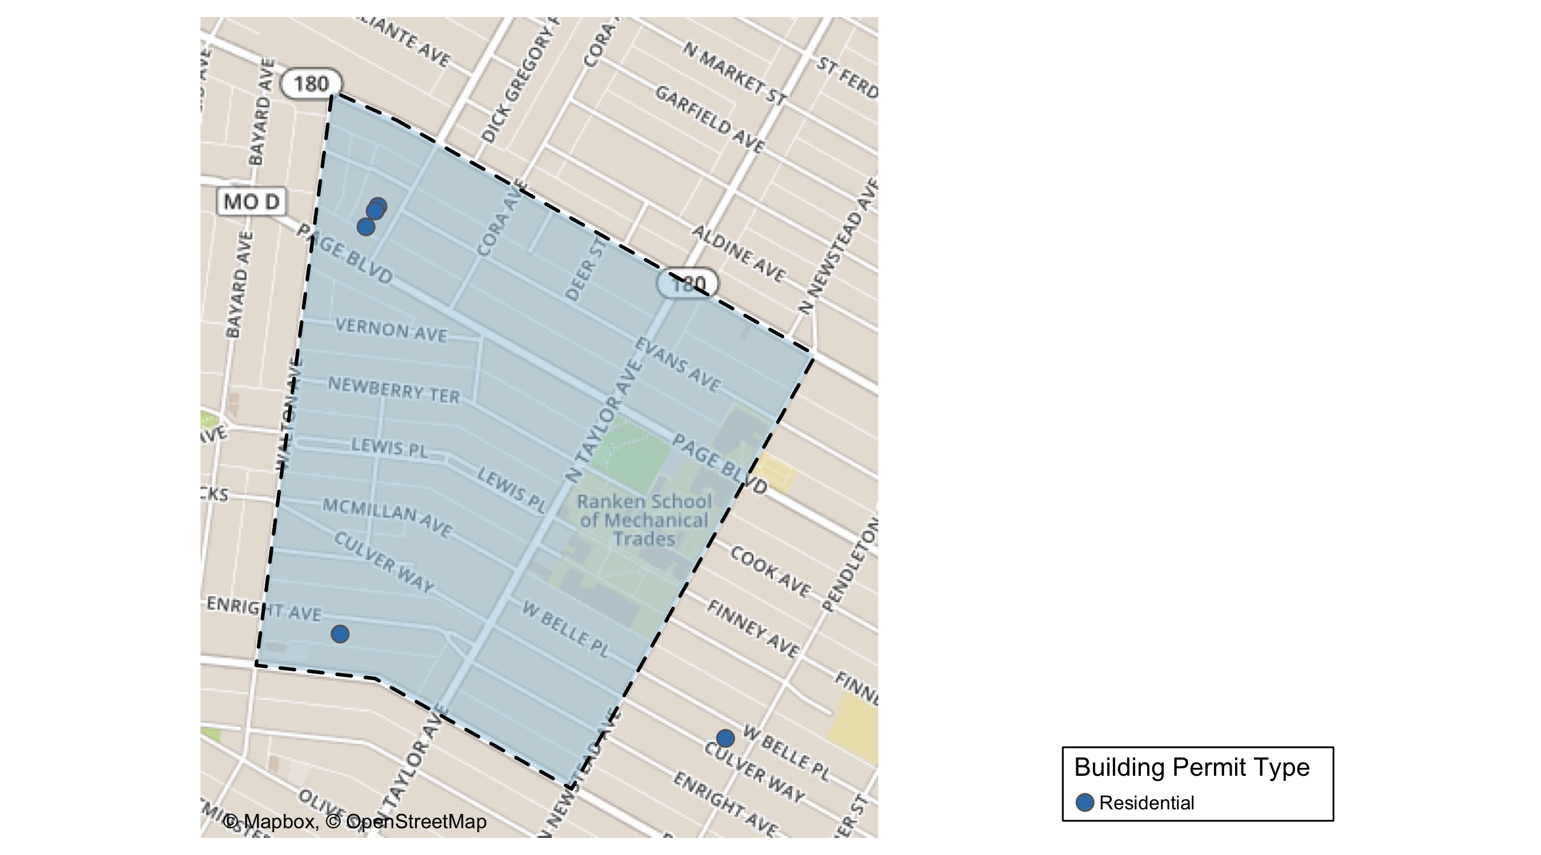
Lewis Place

Slide 51
Lewis Place
December 2020 | December 2020 | December 2020 | December 2020
Permit Use | Average Cost | # of Permits | Total Value of Permits
Commercial | $0 | 0 | $0
Industrial | $0 | 0 | $0
Institutional | $0 | 0 | $0
Residential | $5,993 | 5 | $29,963
Last 6 Months | Last 6 Months | Last 6 Months | Last 6 Months
Permit Use | Average Cost | # of Permits | Total Value of Permits
Commercial | $10,000 | 1 | $10,000
Industrial | $0 | 0 | $0
Institutional | $10,000 | 1 | $10,000
Residential | $29,209 | 13 | $379,723

Slide 52
Lewis Place Individual Permit Breakdown
Owner | New Use | Cost | Address
ENOMIELL HAULING LLC | Residential | $17,640 | 4427 ENRIGHT AV
CALHOUN, AARON J | Residential | $5,323 | 4618 ENRIGHT AV
EBO PROPERTIES LLC | Residential | $3,000 | 1335 MARCUS AV
EBO PROPERTIES LLC | Residential | $1,000 | 1337 MARCUS AV
EBO PROPERTIES LLC | Residential | $3,000 | 1325 MARCUS AV

Slide 53
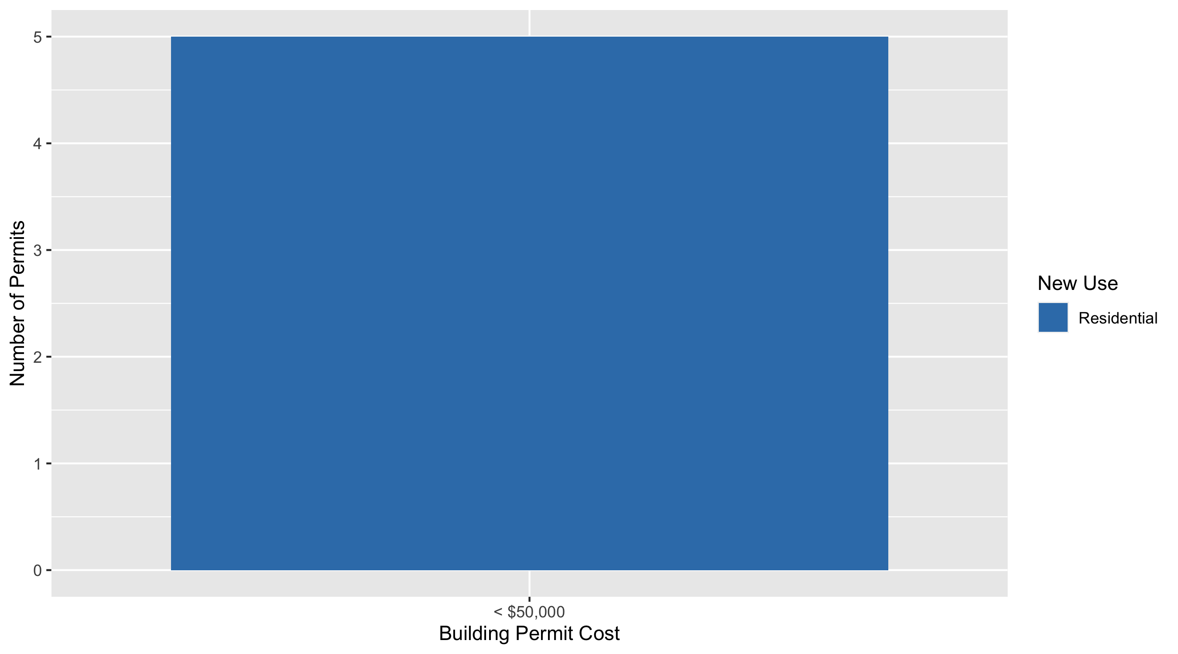
Lewis Place Permit Cost Breakdown

Slide 54
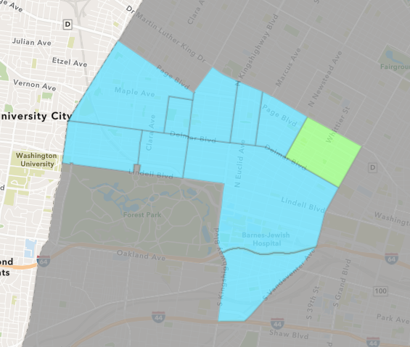
Vandeventer
December 2020 Neighborhood Cost Breakdown
Mean: $6,000
Median: $6,000
Range: $6,000 - $6,000

Slide 55
Vandeventer: Summary Notes
1 building permits in December 2020
-50.00% change compared to December 2019 (2 total building permits)
$6,000: Average building permit cost in December 2020
-90.20% change compared to December 2019 ($61,250)
16 total building permits in 2020
-51.52% change YTD compared to this time in 2019 (33 total building permits)
$43,847: YTD average building permit cost in 2020
-60.80% change YTD compared to this time in 2019 ($111,850)

Slide 56
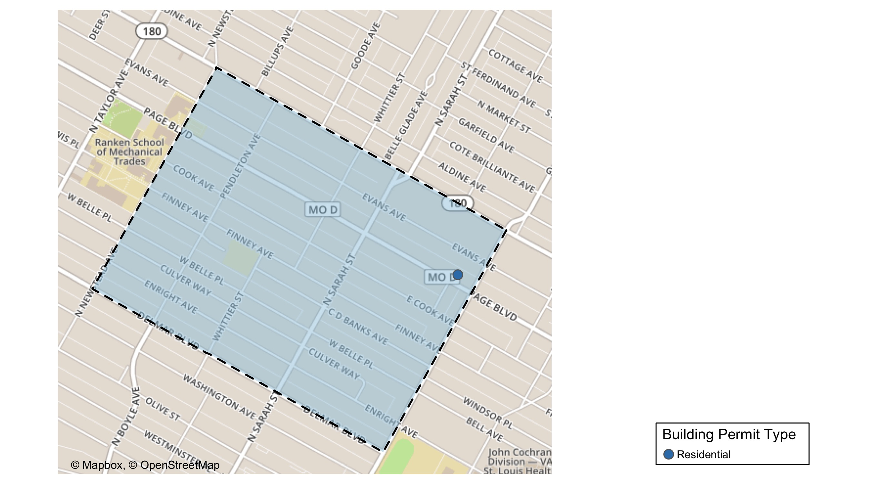
Vandeventer

Slide 57
Vandeventer
December 2020 | December 2020 | December 2020 | December 2020
Permit Use | Average Cost | # of Permits | Total Value of Permits
Commercial | $0 | 0 | $0
Industrial | $0 | 0 | $0
Institutional | $0 | 0 | $0
Residential | $6,000 | 1 | $6,000
Last 6 Months | Last 6 Months | Last 6 Months | Last 6 Months
Permit Use | Average Cost | # of Permits | Total Value of Permits
Commercial | $0 | 0 | $0
Industrial | $0 | 0 | $0
Institutional | $30,512 | 2 | $61,023
Residential | $36,564 | 7 | $255,949

Slide 58
Vandeventer Individual Permit Breakdown
Owner | New Use | Cost | Address
CRAWFORD, DOROTHY W | Residential | $6,000 | 3919 PAGE BLVD

Slide 59
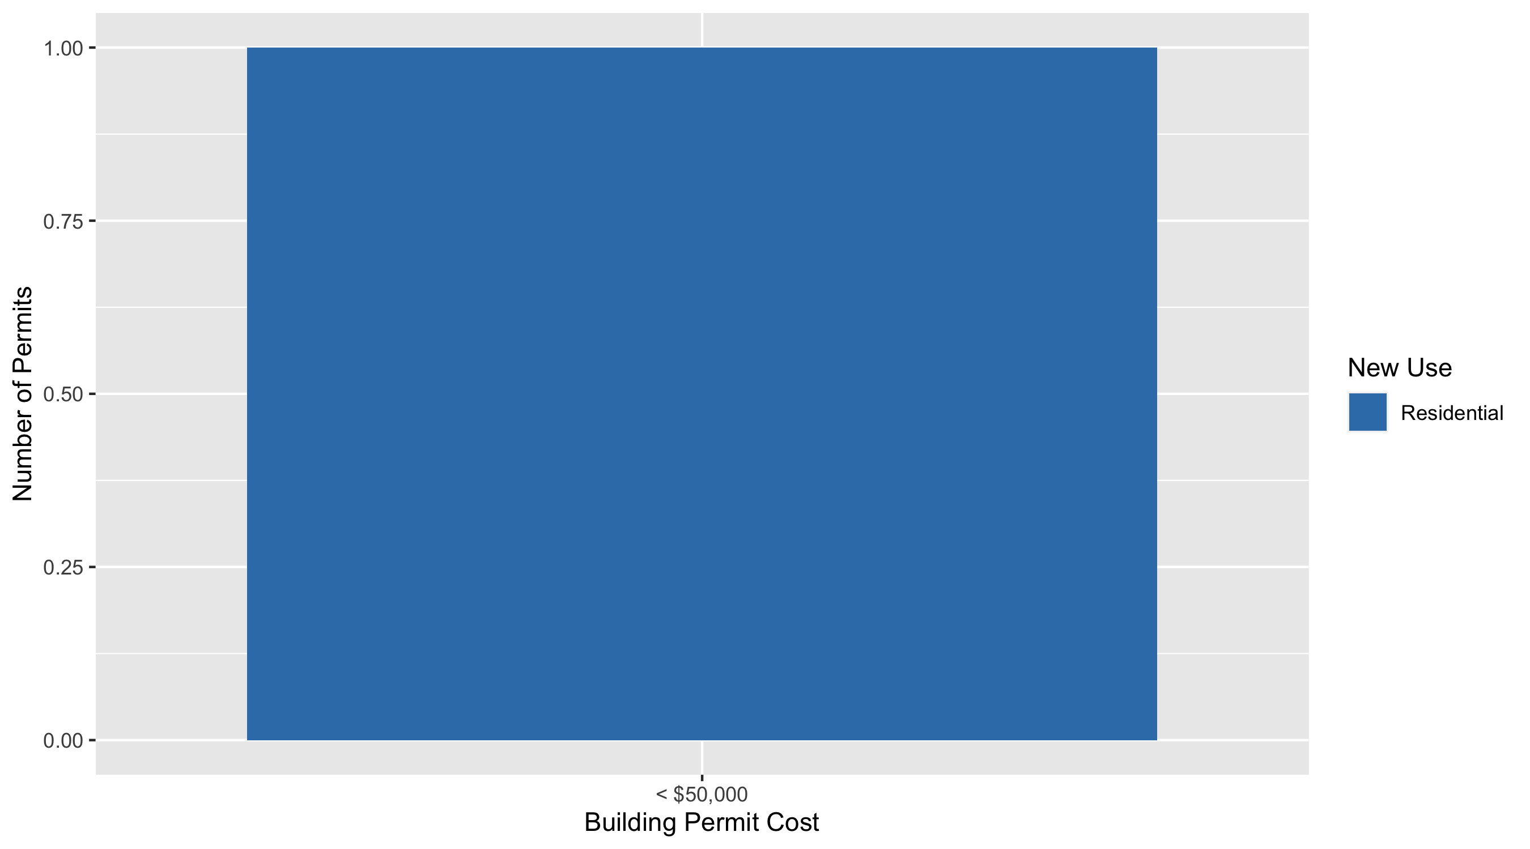
Vandeventer Permit Cost Breakdown

Slide 60
Additional Notes
Data retreived from https://www.stlouis-mo.gov/data/
Building permits with a cost of $0 were dropped
Building permits that were cancelled were dropped
Infinite change indicates 0 permits in the current or previous time period/comparison month so there was a overall increase or decrease

